Slide 1
CBS
Crime Bureau Mgt System
Submitted by
Mr. Gole sumit suresh
Mr. Gunjal bhushan harishchandra

Slide 2
INTRODUCTION
In this Project we are describing the Computerized system for “Crime Bureau”. We had studied this system with respect to the criminal record. The “Crime Bureau Management System” is use to manage the criminal record and create the systematic presentation of the data into the system. It helps to generate the report of the criminal including all the necessary information about the criminal. Which help to reduce the paper work and to avoid the misuse of the data. The system provide all the computerize process which include all the operation.
The system has various modules that can describe the whole process which carried out in the criminal investigation process.

Slide 3
SCOPE OF THE SYSTEM
1. This project is for maintaining the database which compose of the reports , documents and analysis.
2. This system contains the each process from the beginning also it is very time saving.
3. The proposed system invented to make working environment and simpler method.
4. It helps in solving all the hurdles and difficulties currently faced by police.
5. This proposed system is completely user friendly and else better to access.
There is no loss of information as all of stored in secured data base.
Reduction of paper work is accomplish.

Slide 4
System Design
After the analysis it must be clear what must be done. In system design, we plan how to do it. The objectives of the system design are to decide in general how the system should be implemented. Individual physical components, Program files, documents, will be identified. During the analysis we prepare a blue print for the system.
Actually, the system design is the process of planning a new business system or one to replace or complement an existing system. Analysis what the system should do and design specifies how to do and design specifies how to accomplish the objectives. System design begins with a search for alternative solution.

Slide 5
ACKNOWLEDGEMENT
It gives us great pleasure to present our project report on “Crime Bureau Management System” for Police Station. As per requirement of curriculum of the course BBA [COMPUTER APPLICATION] from the Savitribai Phule Pune University at the S.M.B.S.T. college.
First we heartly thankful to project conductor and guide Prof. Dhage H.Y for selecting this project and for his guidance and encouragement at every step in our way completing this project.
We would also like to thanks Mr. Sachin Varpe sir, Prof. Dhage Sir and Prof. Kashid sir H.O.D. of B.C.A. department of our college for giving us important guidance during Project.
Lastly we would like to thanks all the staff members of BBA [COMPUTER APPLICATION] Dept of S.M.B.S.T. College Sangamner for their help to provide information to complete this project.

Slide 6
ANALYSIS
Requirement analysis means identification & understanding & critically examines the system & its subsystem for purpose of achieving objectives for the system. The basic objectives of system analysis are to understand & modify the system in some way to improve the functioning.
1 . Details of Criminal and their type of Act .
2 . On one button click generate FIR Report & Criminal Report.
The above information can be given to a high extend using the proposed project.

Slide 7
FEASIBILITY STUDY
Technical :-
The system is developed using Visual Studio 2008 and SQL Server that already installed Data entry and report generation is easy and user friendly.
Economical:-
Economic feasibility is basically cost benefits analysis the cost concern are since the software has been already installed there is no additional cost in installing the system.
Operational :-
A proposed system is beneficial only if they can be turned into information system that will need the organization operating requirement.

Slide 8
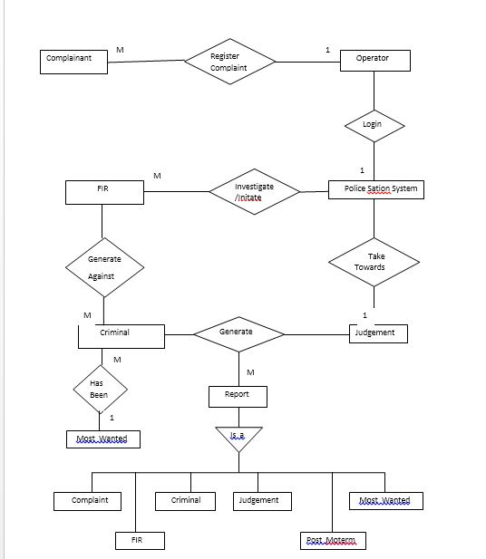
ER-DIAGRAM:-

Slide 9
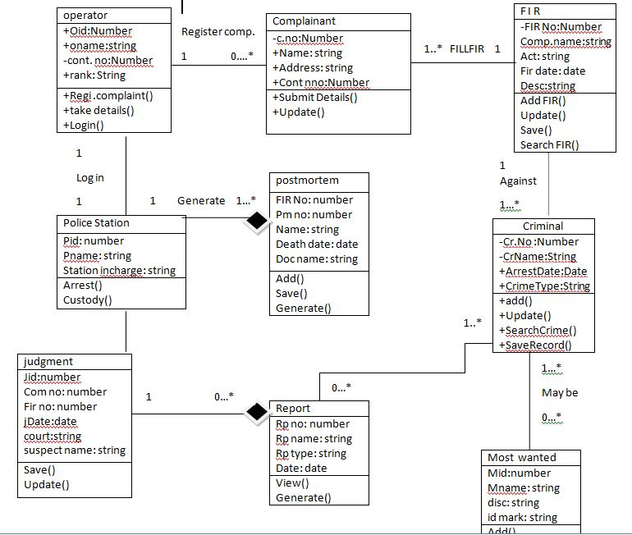
Class Diagram:

Slide 10
State Chart Diagram:
Registration
No
Validate
Admin Login
Yes
Create FIR , Register complaint ,Add Criminal
Investigate/ judgement
Display/Generate Reports

Slide 11
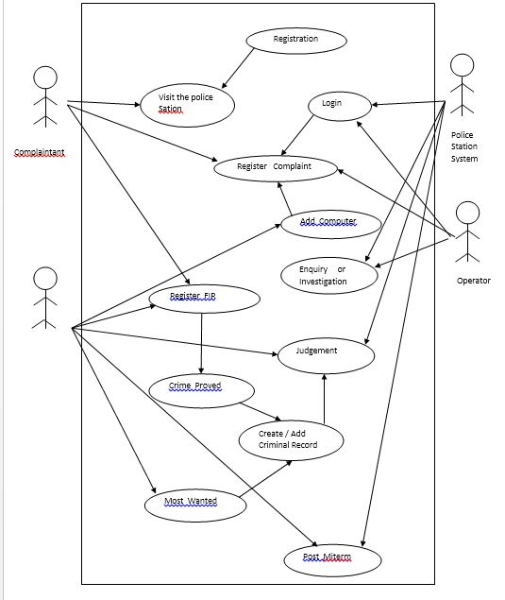
Use Case Diagram:

Slide 12
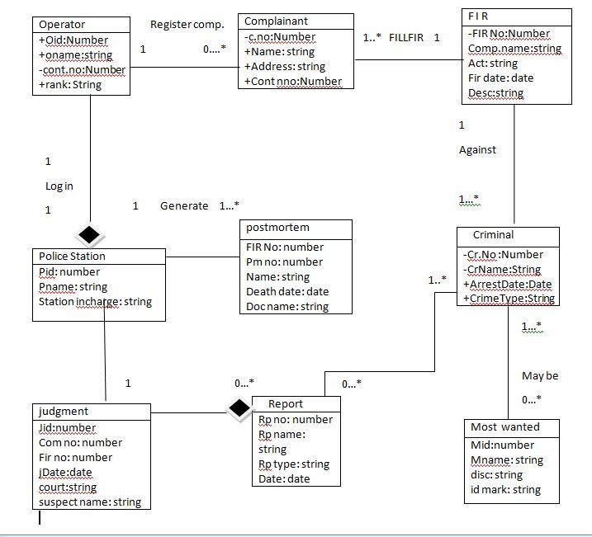
Object Diagram:

Slide 13
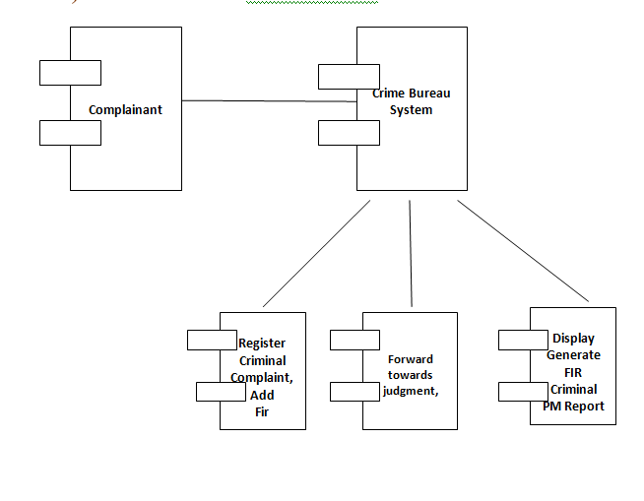
Component Diagram:

Slide 14
Activity Diagram:-
Complainant
System
Database
Visit Bureau
Display Home
Admin Login
Verify Login
Add FIR,Criminal
Forward to Judgement
Display Reports
Logout

Slide 15
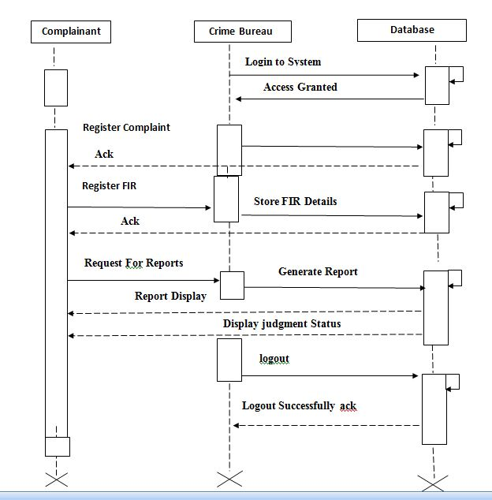
Sequence Diagram :-

Slide 16
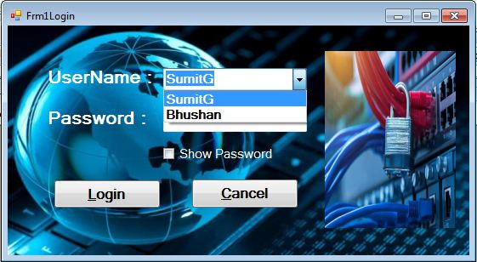
ScreenShots (Input Forms):-
Login Form:-

Slide 17

Main Form:-

Slide 18
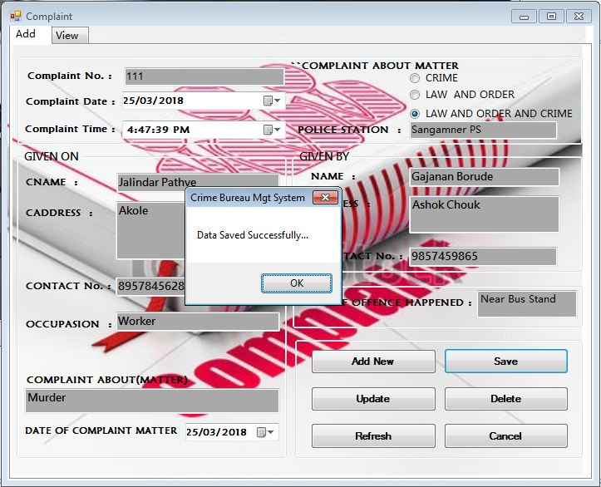
Complaint:-

Slide 19
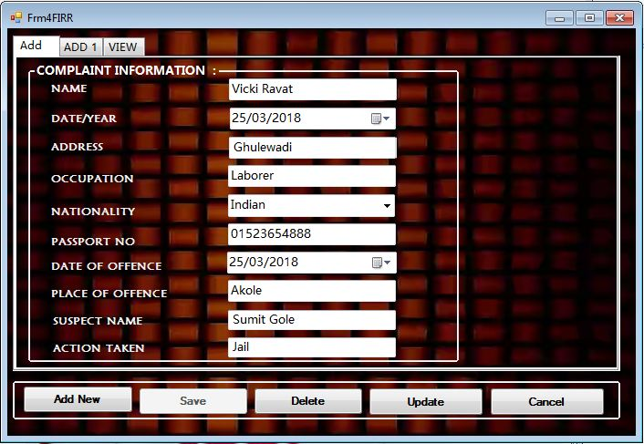
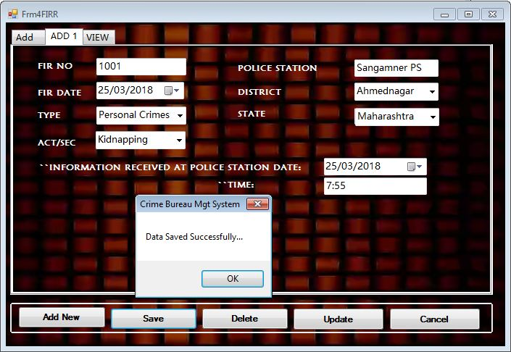
FIR :-

Slide 20
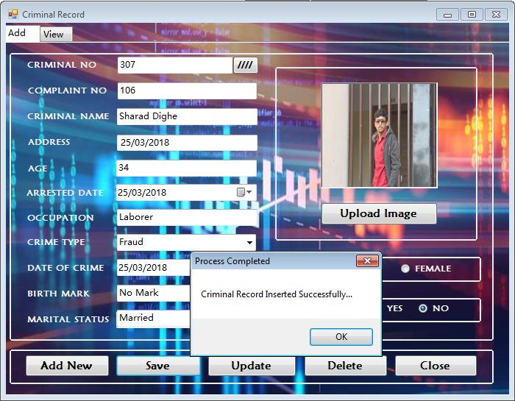
Criminal :-

Slide 21
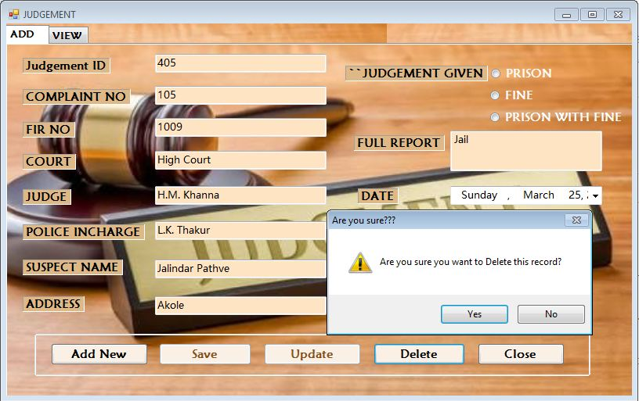
Judgement :-

Slide 22
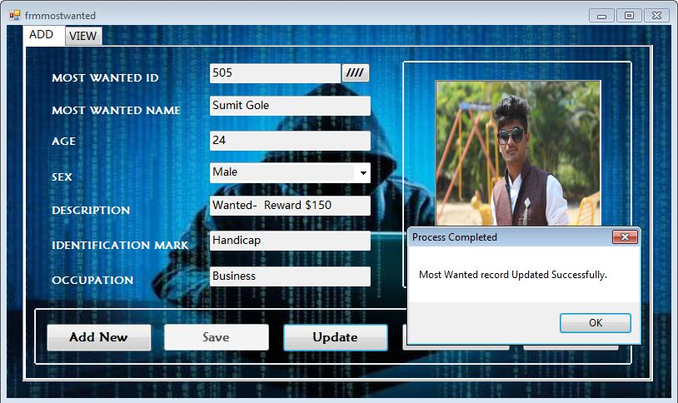
Most Wanted :-

Slide 23
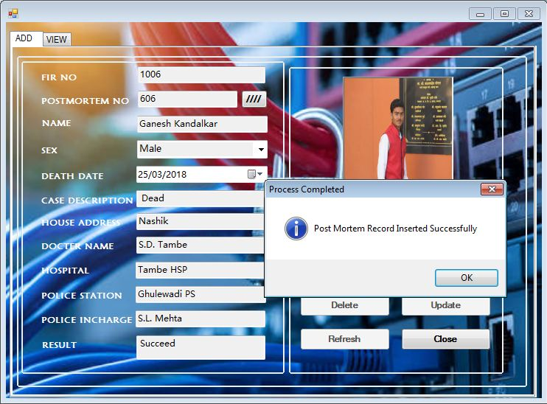
Post Mortem:-

Slide 24
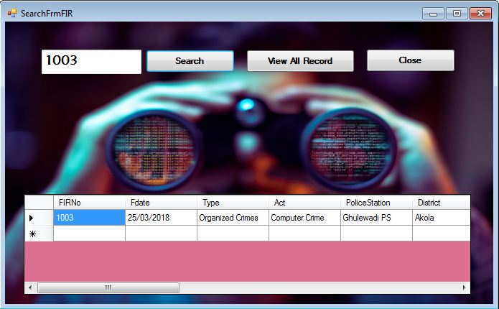
Search Forms :-

Slide 25
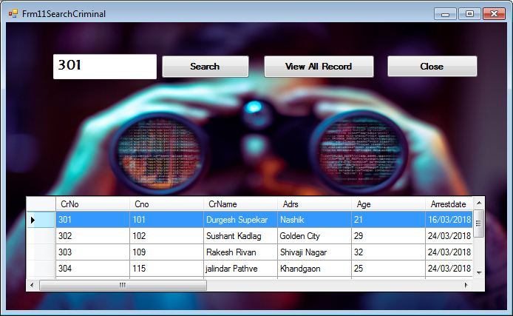

Slide 26
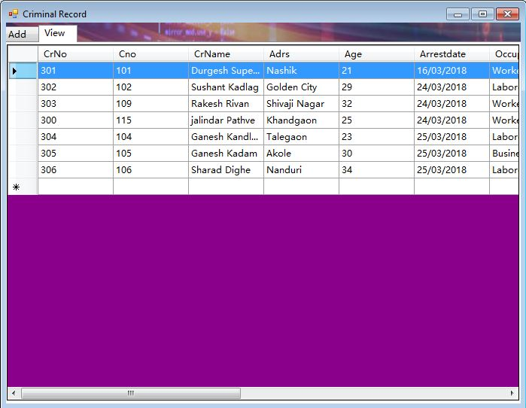

Slide 27
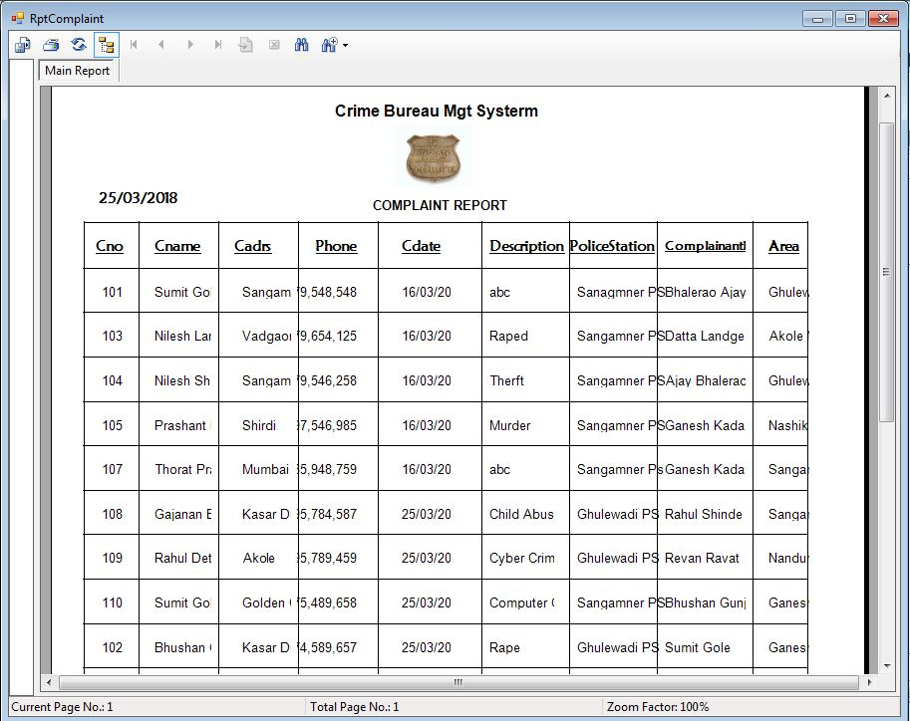
Reports:-
Complaint Report :-

Slide 28
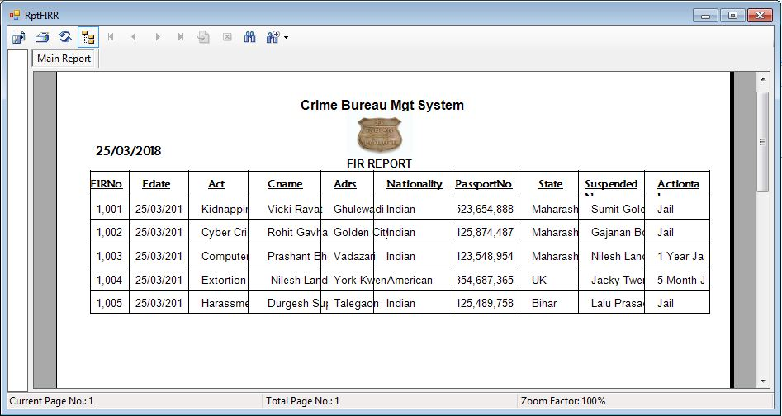
FIR Report :-

Slide 29
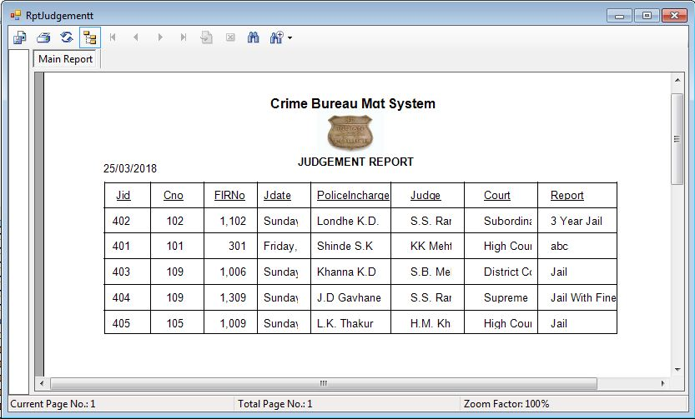
Judgement Report:-

Slide 30
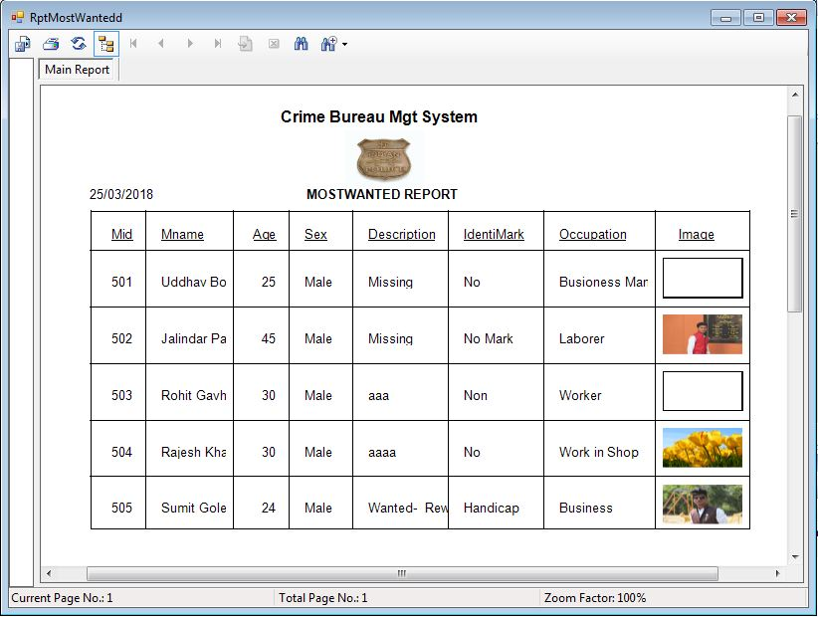
Most Wanted Report:-

Slide 31

BIBLIOGRAPHY
Books used as a reference to provide the guidelines for analyzing, documenting and designing our Project Attendance Analysis:
The Complete Reference Book of VB.NET
By - Jeffrey R. Shapiro
Object Oriented Software Engineering
By - Roger Pressmen
Visited websites:-
http://www.guideproject.com
http://www.ebooks.com
http://www.youtube.com
http://www.tutorialspoint.com
Thank You……..!

